Slide 1
GIA - IAA
Introducció a l’Aprenentatge Automàtic
8. Lab: Clustering
Jordi Luque
jordi.luque.serrano@upc.edu

Slide 2
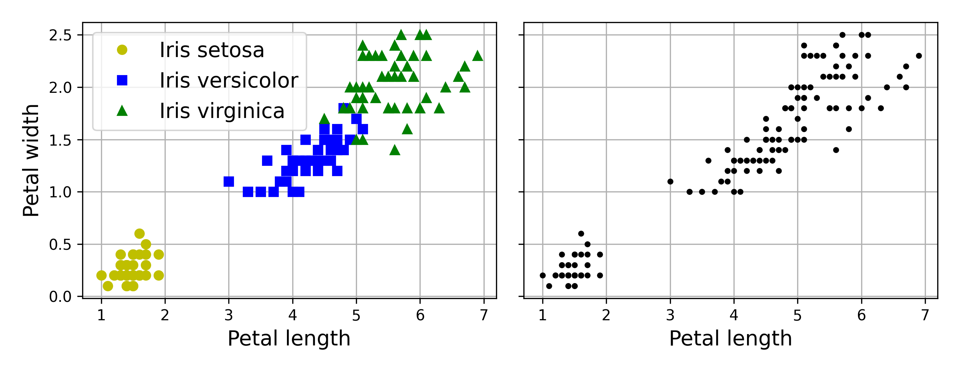
Clustering vs Classification

Slide 3
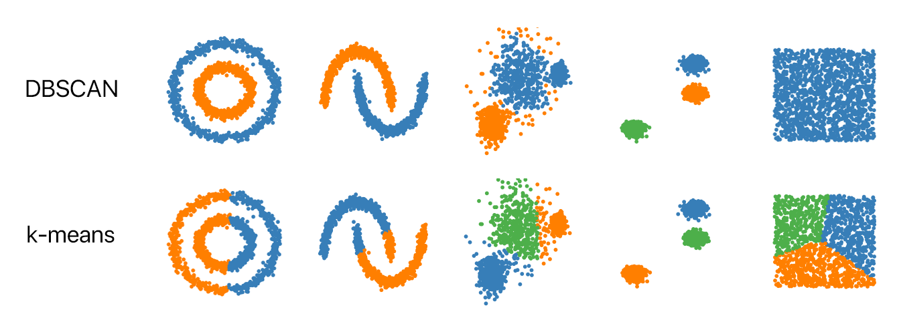
Clustering
There are 4 major categories of clustering algorithms:
Centroid-based Clustering
Density-based Clustering
Distribution-based Clustering
Hierarchical Clustering

Slide 4
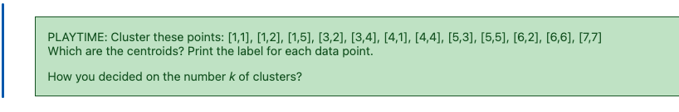
K-Means Clustering
For many of us, if we're familiar with clustering algorithms at all, we know about k-means clustering. Is one of the most widely used clustering algorithms. It aims to partition the data into K clusters, where K is a predefined number.

Slide 5
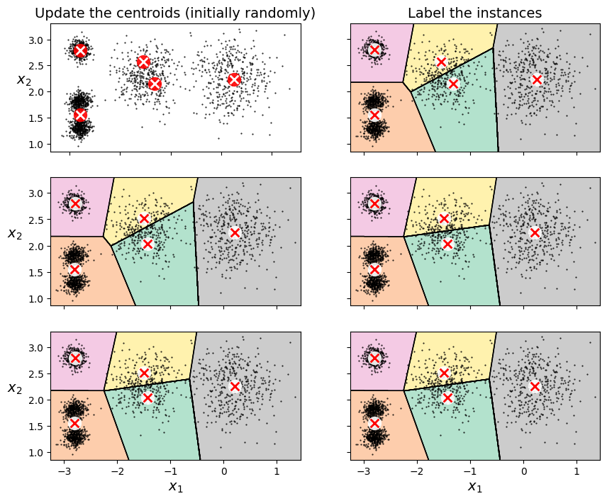
K-Means Clustering
It iteratively assigns data points to clusters based on the proximity to the cluster centroids and updates the centroids until convergence.
One of the challenges with k-means is that you need to specify a number of clusters ("k") in order to use it.

Slide 6
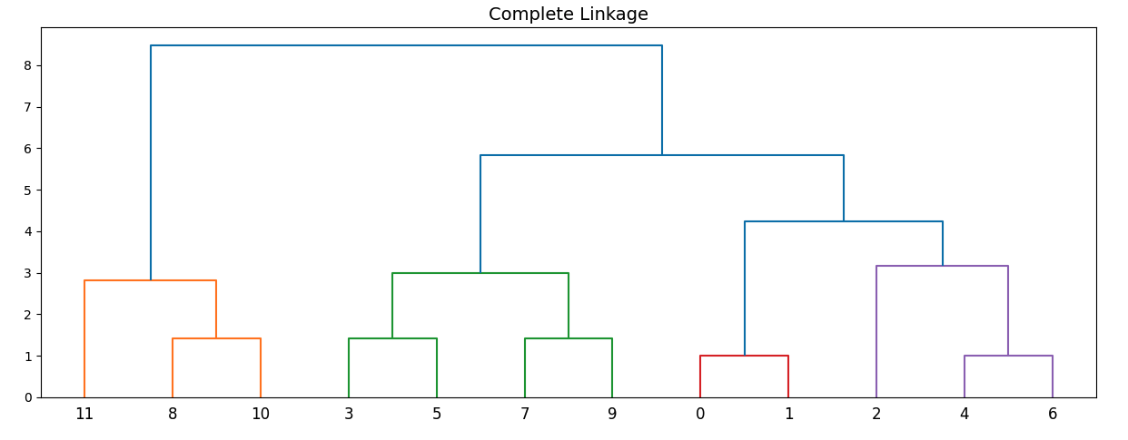
Hierarchical Clustering
This approach creates a hierarchical decomposition of the data by iteratively merging or splitting clusters. It can be agglomerative (bottom-up) or divisive (top-down) in nature. The result is often visualized as a dendrogram, which shows the nested clusters at different levels of similarity.

Slide 7
Hierarchical Clustering
This approach creates a hierarchical decomposition of the data by iteratively merging or splitting clusters. It can be agglomerative (bottom-up) or divisive (top-down) in nature. The result is often visualized as a dendrogram, which shows the nested clusters at different levels of similarity.
https://docs.scipy.org/doc/scipy/reference/generated/scipy.cluster.hierarchy.linkage.html

Slide 8
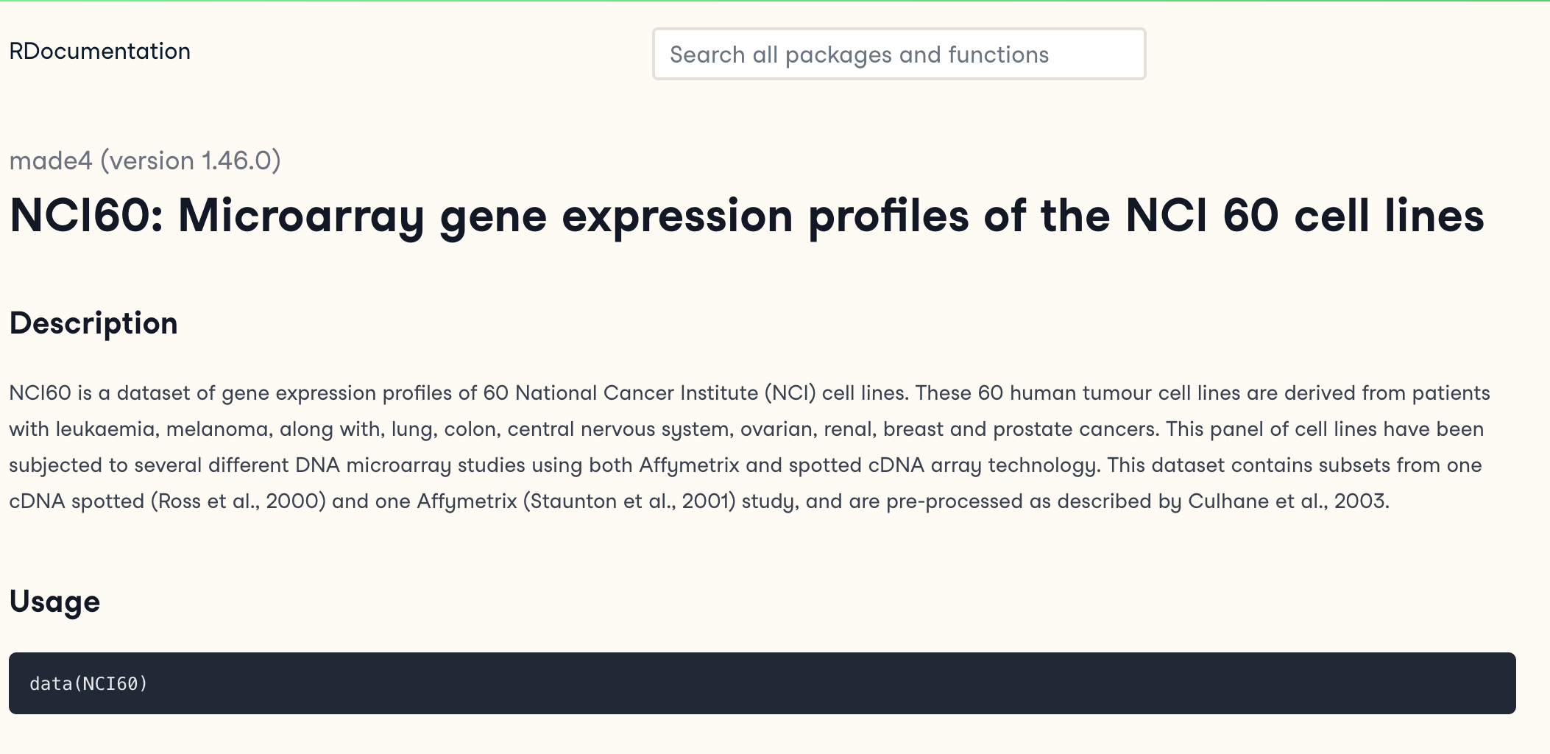
NCI60 Dataset
https://rdocumentation.org/packages/made4/versions/1.46.0/topics/NCI60

Slide 9
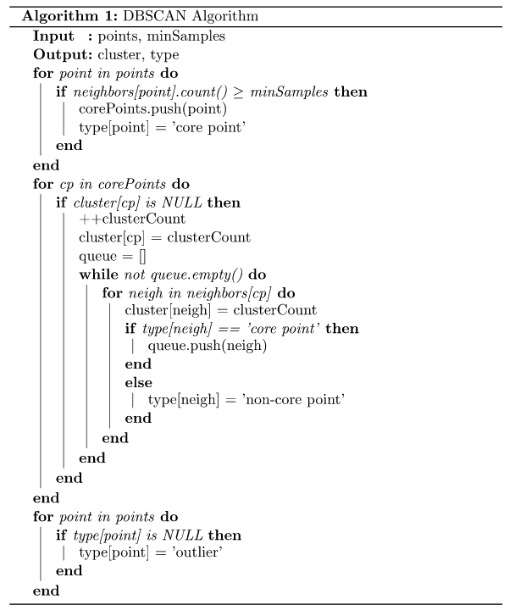
DBSCAN Clustering
DBSCAN (Density-Based Spatial Clustering of Applications with Noise) group together data points that are within a dense region in the data space and separate them from sparser regions. Only have two parameters.
Radius (epsilon)
High: Larger clusters. Irregular.
Small: Smaller clusters, more noise points. Spherical
Num. min. points:
High: Denser clusters
Smaller: Sparser clusters
https://cdn.aaai.org/KDD/1996/KDD96-037.pdf

Slide 10
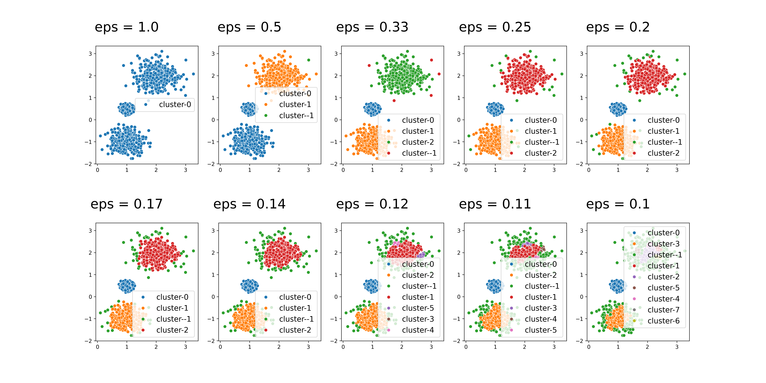
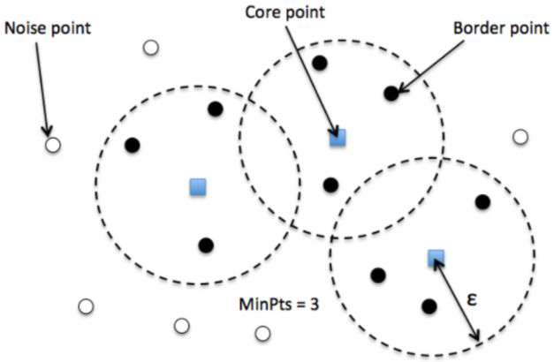
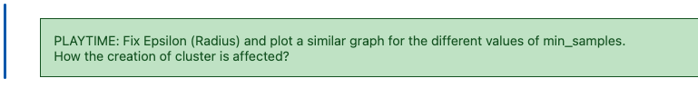
DBSCAN Clustering
https://cdn.aaai.org/KDD/1996/KDD96-037.pdf

Slide 11
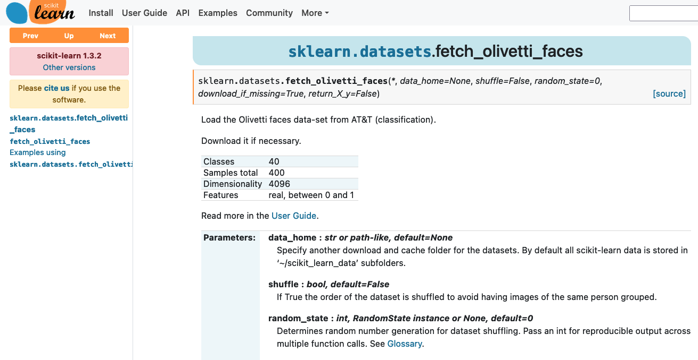
Olivetti Faces Dataset
https://scikit-learn.org/stable/modules/generated/sklearn.datasets.fetch_olivetti_faces.html

Slide 12
Olivetti Faces Dataset
https://scikit-learn.org/stable/modules/generated/sklearn.datasets.fetch_olivetti_faces.html

Slide 13
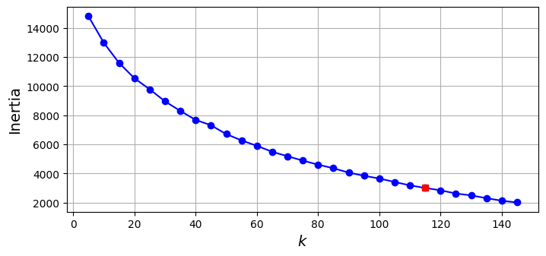
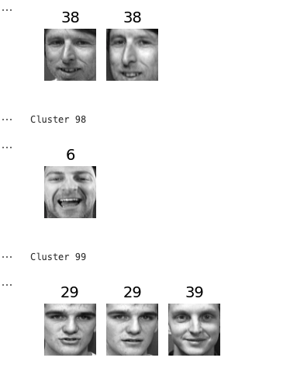
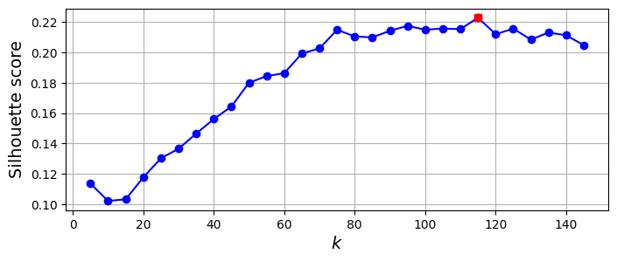
Olivetti Faces Dataset
https://scikit-learn.org/stable/modules/generated/sklearn.datasets.fetch_olivetti_faces.html

